Slide 1
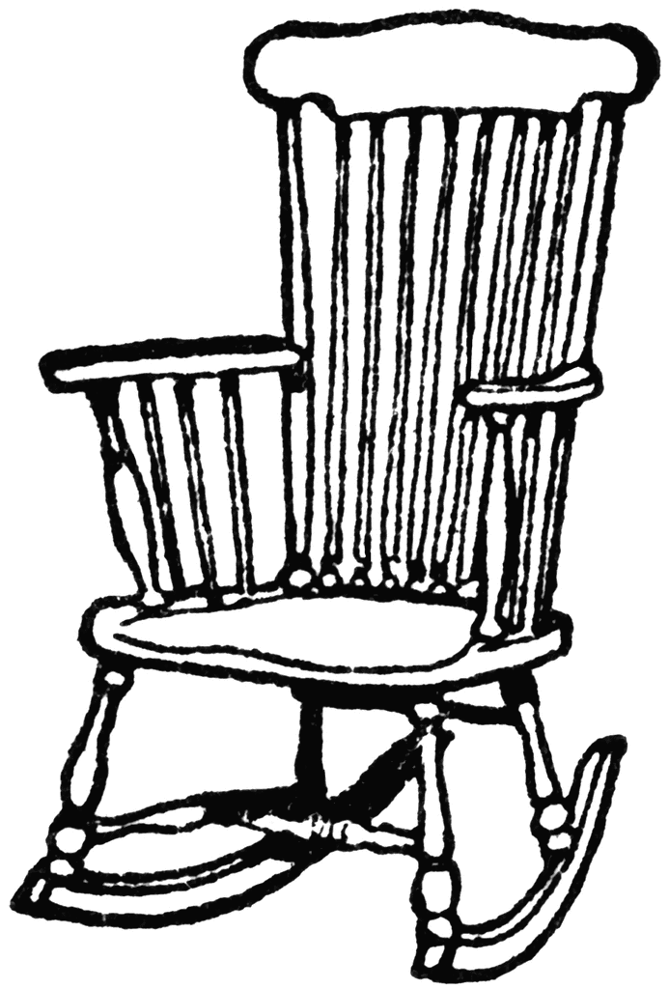


Active Ageing
Presented by TEAM CHILLAX:
Abhilasha Kumari || Ashok Eapen
Pranav Agarwal || Rohit Pattnaik

Slide 2
Content
Introduction
Survey
Active Aging Index
Persona
Prototype
Conclusion

Slide 3
Introduction

Slide 4






Design Challenges | Sneak Peek
Starting Point
WHO Reports 2002
UNECE 2012 (Economic Commission of Europe Reports)
Average age for Retirement
(Numbers in Years)
Points to ponder
Retirement age ?
Data sources on the situation ?
National, regional or local-level policy ?
Level of political support and awareness ?
Local initiatives ?
Active Ageing Index (AAI) ?
Key challenges limiting the use of AAI ?
Unique societal diversity and needs
Iceland
67
67
Global
65
63.5
India
56-60
56-60
Outcomes expected
5-9
3.5-7.5
Intervention Prototypes
Programs & Policies
Concrete action plans

Slide 5
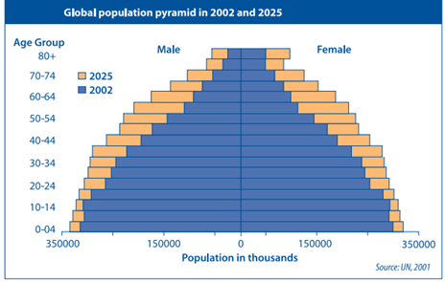
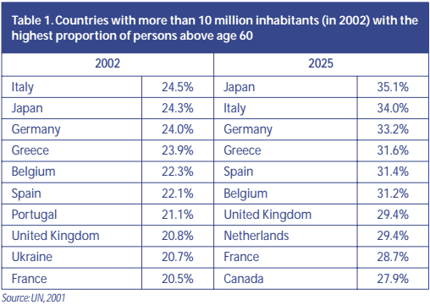
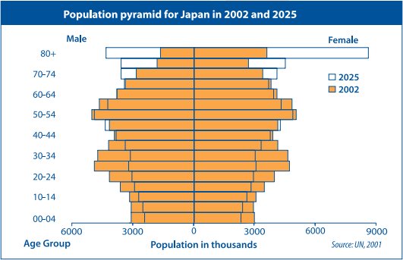
Research | Focus AGE Groups
Special Interest Group
Primary Focus Group
Secondary Focus Group
Courtesy: WHO Active Ageing Policy Framework(2002)

Slide 6

Interviews | Prologue
Area of interest:
Active ageing index(AAI) in Indians
AAI in Indians staying in India Vs AAI staying at abroad.
What is Active Ageing Index ??
My Social Life??
My Financial independence??
Typical Questions asked (Candid Mode)
According to you, When does one start to age?
Employment:
How did you prepare for retirement?
How satisfied were you at work ?
What are the reasons that stop people from working as they get older?
Health :
How do you take care of your health ?
How do you evaluate your physical performance, psychological well being and overall quality of personal and social life?
My safety and Quality of life??
My Health??
Insights into active ageing determinants

Slide 7
Survey

Slide 8
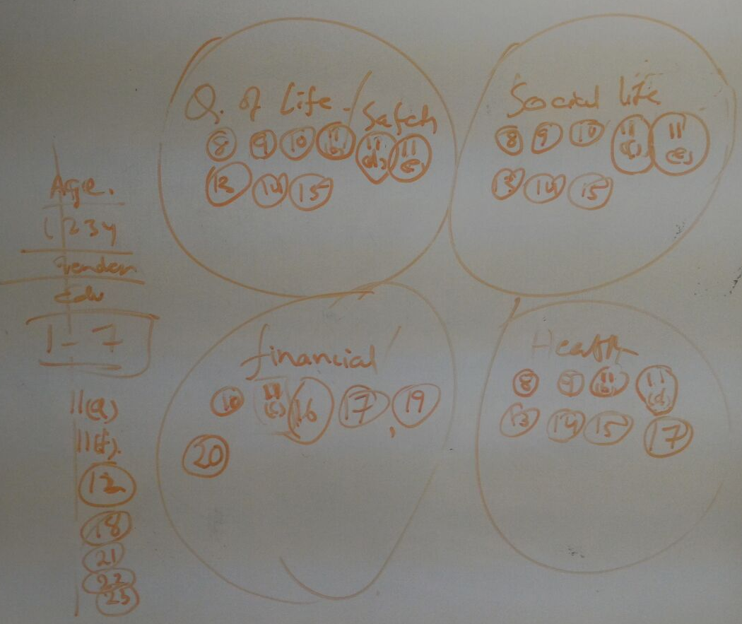
Survey Design | Drawing Board
Insights from the interview
Quality of life/ Safety
Social Life
“I have to lead the same quality of life as before”
- Former Manager ,Citi bank
“My son will take care of me when I retire”
- Former Librarian
“I would like to go back to my hometown and lead a meaningful life with family and friends.”
-- Army Officer
“I would like to strengthen my social network and contribute to social causes.”
-- Business Consultant
Financial independence
“There is no age to retire till a
person is willing to work” and 65 is a very little age to retire”
– Former VP ,TATA STEEL
“I have saved money for my Second Innings” ,I will open my own business”
-- IT professional
Health
“You would get old when you think you are old”. I feel fit, I exercise and stay stress free.
--- Professor
“I have an health insurance to take care of my health in my old age.
--- Taxi Driver
White Board Model

Slide 9
Survey Summary | Preliminary Analysis
Participating Age Groups
91 Valid Responses Across
5 Countries
Demographics
Age [65 > x > 50] as our Primary focus group
Age [x < 50] as our
Secondary focus group
Age [x > 65] as our Special Interest Group
69.3% respondents from India are considered as the primary group response
Rest 30.7% responses from non resident Indians are a mark of satisfaction and AAI abroad

Slide 10
Survey Findings | Living Life as it comes
Participants Age distribution
44% of respondents feel Greater than 70 years of age is truly an old
However retirement age of 56-60 (In India) doesn’t do justice to the population

Slide 11
Living Preference | Survey Findings
This confirms the congruency of 70.3% Married individuals flocking in a family environment and a feeble 19.8% staying alone
However 30.8% of respondents who would like to live independently post retirement

Slide 12
Social Inclinations | Survey Findings
Good to observe that only 5.5% of the sample set is undecided on how they want to lead their lives post retirement
The respondents who would like to live independently may have the inclination to pursue Leisure activities and hobbies

Slide 13
Social Activity | Survey Findings
70.3% of the sample respondents are interested in social volunteering work.
However 68.1% spend <20 hours per month

Slide 14
Social Perception Dilemma | Survey Findings
23.1% Have skill Set mismatch
52.8% Hard to reach
31.9% of the sample respondents are not interested in volunteer work.
20.9% are not aware on how to go about volunteer work

Slide 15
Financial Stability | Survey Findings
Whopping 80.2% respondents want to work post retirement
56.1% respondents agree that increasing retirement age is the need of the hour
56% of the respondents want to work post retirement with partial pension and part time job

Slide 16
Then Why Quit? | Survey Findings
NO Clear Victors Here ….. All parameters are fairly important

Slide 17
Health Care and lifestyle | Survey Findings
Good overall level of satisfaction, greatly points towards better active ageing index

Slide 18
Expectation Vs Reality | Survey Findings
Interesting Metric Showing the Expectation Vs Reality GAP
Satisfaction of the public yields more Expectation and desire for change.

Slide 19
Technical adeptness | Survey Findings
Participants Age distribution
Key determinants for success of prototype:
Accessibility of service to target groups
Ease of use
Optimizing opportunities for health, participation and security
The Prototype that we develop has to take all the above parameters into account

Slide 20
Active ageing index

Slide 21
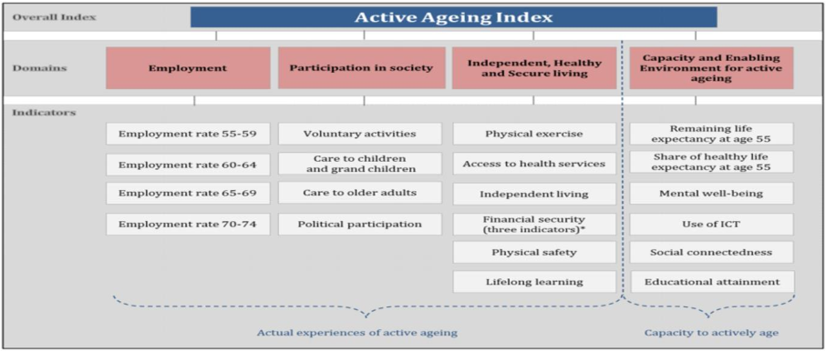
Active Ageing Index -- AAI | UNECE Model

Slide 22
Active Ageing Index -- AAI | Naïve Model
Active Ageing Index calculation METHOD:
43 Data Points on Likert Scale Evaluated
All data arranged in Descending order of favorability to active ageing
Scale worth varying between 2-5
${\left(Normalized AAI Score\right)}^{}=\frac{10}{149}∗(\sum_{k=0}^{n}{{(Likert Scale Values)}^{}}$- 43)
Interpretation of AAI and Normalized AAI
Increasing Risk
Better Active Ageing
Absolute Score
Minimum : 43
Maximum : 192
Normalized Scores
Minimum : 0
Maximum :10
0
10
0
10

Slide 23
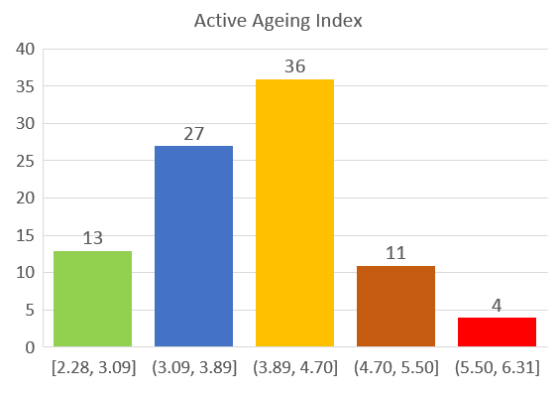
Active Ageing Index -- AAI | Data Model Check
13 individuals in Least Risk Zone
27 individuals in Low Risk Zone
36 individuals in Border line Zone. Warning for Active ageing
11 individuals in High Risk Zone . Moderate Intervention Required
4 individuals in Extreme Risk Zone. Maximum Intervention Required
Better Active Ageing
Increasing Risk/ Intervention

Slide 24
Persona

Slide 25



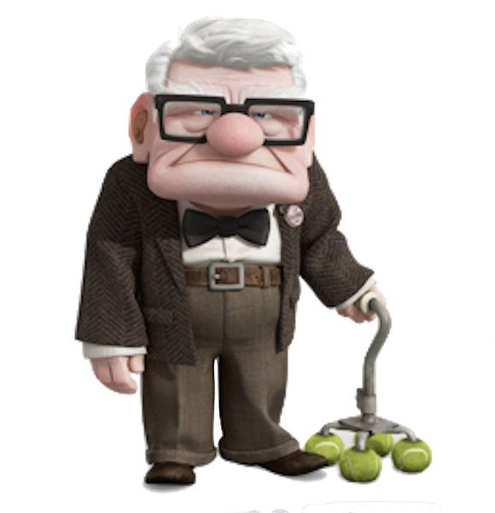
Interviewee Synopsis | PERSONA 1/2
Johnny
Ariel
Dr.Nefario
Carl
Age Group
<50
50-60
60-65
>65
Education
Undergraduate
Postgraduate
Post Doctoral
Postgraduate
Occupation
Engineer/white collar
Manager/white collar
Scientist, Retired, Silver Skill
Retired Executive
Physically fit
Overall General satisfaction
Physically fit
Overall General satisfaction
Physically mobile
Deteriorating Health
Overall General satisfaction
Reduced Mobility
Deteriorating Health
Chronic condition
Health Attributes
Party Animal
Trekking & adventurer
Community work
Gamer
Selective Social Group
Family oriented
Highly selective core group
Community Work
Scientific community
Limited Interaction
Community Work
Social Attributes

Slide 26
Interviewee Synopsis | PERSONA 2/2
Johnny
Ariel
Dr.Nefario
Carl
Low-Medium Income
High expenditure
No investments
Medium-High Income
High expenditure
Immovable property investments
High Income
Low expenditure
Immovable property investments
Intellectual Property
Low Income
Low expenditure
Immovable property investments
Financial Attributes
Expert in new tech
Uses multiple modes of communication
Expert in new service exploration
Good in new tech
Uses limited modes of communication
Expert in new service exploration
Good in new tech
Uses limited modes of communication
Bad in new service exploration
Struggles with new tech
Uses limited modes of communication
Bad in new service exploration
Technical Adeptness
Reachability
Interest

Slide 27
Prototype

Slide 28
Intervention Plan | Prototype
Engagement Model
Universal Identification System (UID)
Need Based
Rights Based
Communication / Awareness
Digital
Printed
Word of mouth
Tele calling
Mobile applications
AAI
INTERVENTION Required
Medical intervention
Financial Intervention
Social Intervention
WARNING Required
Medical Warning
Financial Warning
Social Warning
INTERVENTION not Required

Slide 29


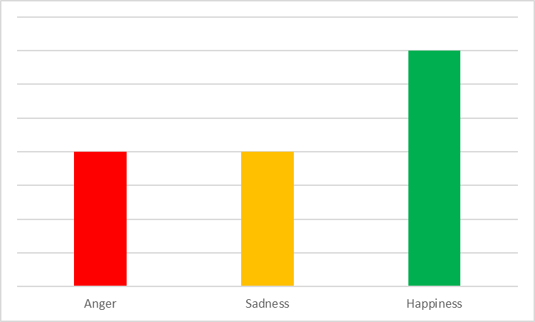

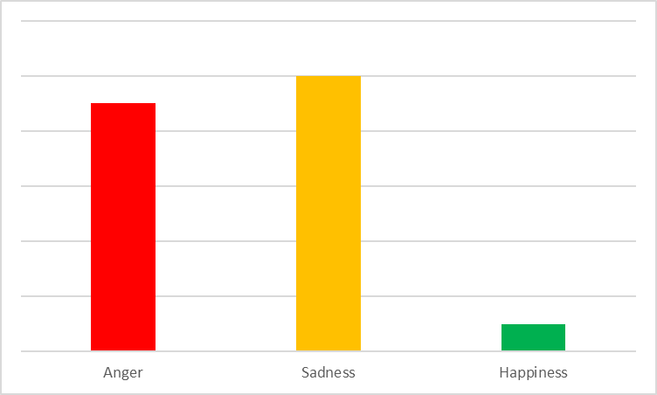

Active Need based Interventions Prototype
Symptoms of onset of cardiac problems
Primary Warning
Automatic Follow UP
App Searches for the nearest window of opportunity with doctors using severity of AAI with patient (UID)
App Books appointment and Clears Patient’s work calendar using (UID). Clients Get Automated (OOO) message
Medium AAI Risk Score
Health Insurance Company Notified
Real Time AAI Recalculation
Automatic Report analysis
The Reports and the Health Index is sent to the health insurance provider.
Central AAI calculator recalculates risk for patient and makes it available for other systems
Test confirms coronary disease and doctor updates the Central Health Server regarding patient Condition
High AAI Risk Score

Slide 30
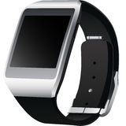
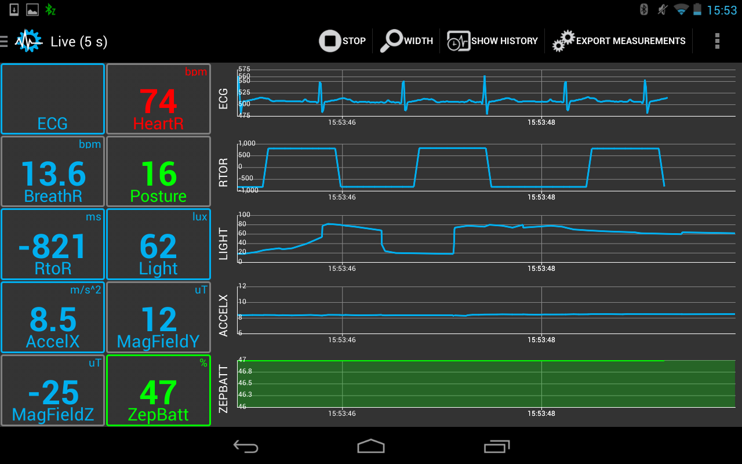
Active Need based Interventions Prototype
Health Insurance Company Issues Monitors
Monitor Condition
History of Condition
The Patients UID is used and a monitoring kit is sent immediately using cashless service
App monitors patient condition real time and sets timers for medication
App updates central server regarding any complications for the patient
Intensive care
Heart attack
Automatic Report analysis
Doctors are updated with patient info very frequently until stable
The health monitor automatically calls emergency services and informs friends
Doctor Automatically updated on patient health via Central Server

Slide 31
Conclusion

Slide 32
Critical evaluation of the methodology
• Holsterin and Minkler (2007) argued that the process of idealization of active ageing might be repressive and counterproductive
• Lay perspective is missing from the active ageing concept – Besides, the AAI framework does not align with the lay perspectives of successful ageing shown by Bowling and Dieppe (2005)
• Active for who? – Individual, households, communities, nations, governments or policy makers
• Very often these frameworks for active ageing are designed by policy makers and academics and these might not reflect preferences of older people

Slide 33
References
UNECE 2012 report: https://books.google.com.sg/books?id=tpVMCgAAQBAJ&pg=PT336&lpg=PT336&dq=UNECE+2012+report&source=bl&ots=3Mo2cHjJj5&sig=xLLACvnNSzY4yyEguIhs3dTr-7o&hl=en&sa=X&ved=0ahUKEwiy48fV9sLSAhVIu48KHbvuCE0Q6AEIPjAH#v=onepage&q=UNECE%202012%20report&f=false
http://www.unece.org/fileadmin/DAM/stats/documents/sustainable_development/2012/Report_on_measuring_sustainable_development_Dec_2012_-_for_consultation.pdf
WHO Report http://apps.who.int/iris/bitstream/10665/67215/1/WHO_NMH_NPH_02.8.pdf
TEDx Silver Skill: https://www.youtube.com/watch?v=AgEFoLS9Bc4
Retirement Age https://en.wikipedia.org/wiki/Retirement_age

